Slide 1
DO WE NEED RELIGION TODAY?
DO WE NEED RELIGION TODAY

Slide 2
Friends, many of you know that I am a strong believer of religion and I try to live up to the principles of my faith.
However, being a scientist, I have some problems in accepting what I was told to believe and practice.
The scientists now know a lot of what was unknown when the religions were founded and developed.

Slide 3
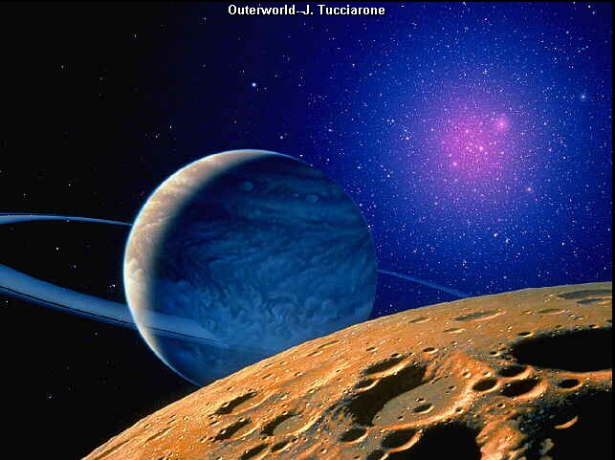
PLANETS & GALAXIES
Earth is no longer accepted to be the center of the universe; the sun and moon are no longer gods to be worshipped by human beings.
As a child I was taught to bow to the moon, our good uncle, 'Chanda Mama'.
Bathing in 'sacred' rivers and giving charity during solar and lunar eclipses were then religious requirements.
Of course, some people out of ignorance do it even today to continue the tradition.
keI koit KwxI Aru KMf ]
Many millions are the fields of creation and the galaxies.
Guru Arjan Dev ji (SGGS) Pg. 276
Notes:
The Universe is the system of stars and galaxies. It is everything that is out there in the sky, and it is immense beyond imagination. In fact, it is difficult to grasp the great distances and large numbers involved in the universe. Our place and existence is tiny compared the everything else.
Galaxies consist of millions of stars. Each star is a sun, similar to our Sun. The Milky Way is a galaxy in which our Sun is a member. By studying the motion of galaxies, the theory of how the Universe began has been established.

Slide 4
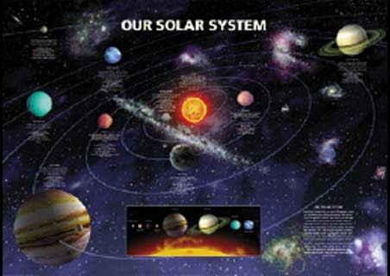
In the west, Galileo was declared guilty and imprisoned for reporting his scientific discovery that the earth revolves around the sun.
His observation challenged the Bible, 'the word of God', and hence he had to suffer.
(In 1986, the Pope confessed before scientists, in a televised speech that Galileo was right and the Pope, who punished him, was wrong.
He regretted the punishment given to the scientist.)

Slide 5
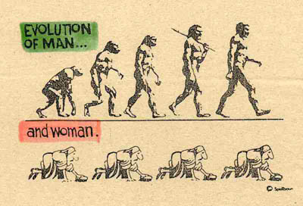
Similarly there was a strong protest by Christians against the theory of evolution.
Darwin was even abused for suggesting that man, as we find this species (Homo sapiens) today, was not created by God but has evolved over time.
Scientists have found that the earliest human being, Homo erectus, who was the first human to walk erect on two feet, is already extinct.
Now, Darwin's theory has become the foundation for the study of the evolution of life on earth.

Slide 6
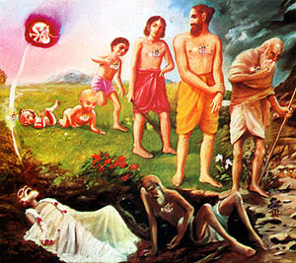
Leaving aside that some beliefs of religions are unacceptable to science, history reports that their contributions to society have been negative.
Let us start from our own country. In 1947 India was divided into Hindu India and Muslim India followed by bloodshed on a vast scale.
It also involved untold miseries to millions of people who moved from one side of the border to the other. Violent sporadic clashes between Hindus and Muslims continue even today.
In the Middle East, some Jews and Muslims (Palestinians) are thirsty for each other's blood. Killings are reported there every week.
Now, Darwin's theory has become the foundation for the study of the evolution of life on earth.

Slide 7
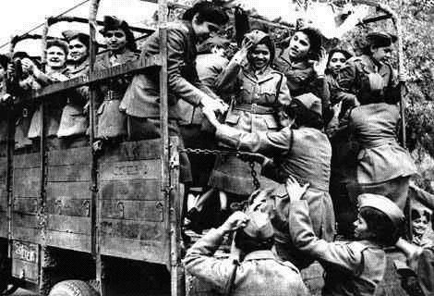
The violent clashes among Catholics and Protestants in Northern Ireland are a long standing problem for the U.K. government.
You may look at any country and find that religion has caused and is still causing bitterness among human relations.
Everywhere it has resulted in the unnecessary loss of life.
Maybe, all this bloodshed in the world could have been avoided if there was no division of people into different religions.

Slide 8
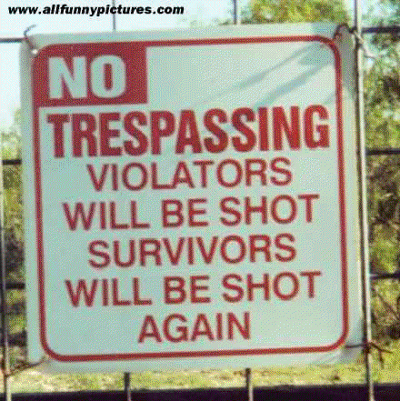
Religions were founded to keep society in social and moral discipline.
It told people not to steal, rob, or tell lies. Religion requires an individual to earn his living honestly.
It prohibits strong people from bullying or bothering the weak by declaring such acts as sins.
Now, all this discipline is being imposed by the government. Law prohibits all anti-social activities and prescribes punishment for those who ignore it.

Slide 9
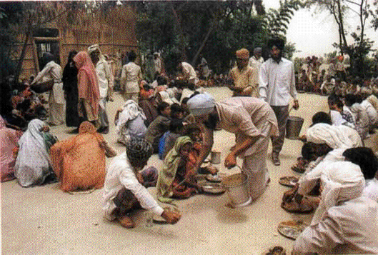
Another advantage of religion is that it directs people to give charity for the welfare of the needy, weak and poor.
This responsibility, too, has been taken over by the government. Out of the tax collected from the people, government provides relief to the sick, old and poor.
In other words, the present social and political structure of society has made religion unnecessary.
What we have been left with as religion is a set of rituals only.

Slide 10
Many of these rituals make little sense to the people of the science and computer age.
Religion, therefore, appears to be irrelevant for leading peaceful and happy lives.
This thought is well reflected in the life of people, particularly, the modern youth.
Lastly, some persons openly say that they do not believe in God.
Further, many of those who claim to believe in religion are seen not practicing it.
People generally show blatant disregard to the instructions of their faith.
This sends a clear signal to the youth that religion is no longer the need of the day.

Slide 11
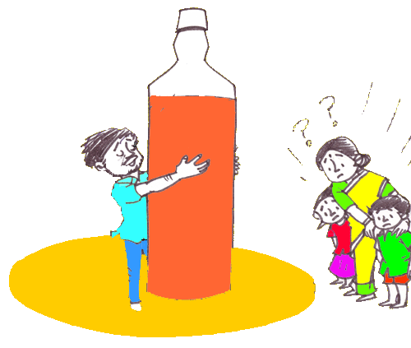
Let us talk about Sikhs as an example. Sikh Maryada requires a disciple to recite Gurbani regularly.
Sikhs are directed not to drink alcohol or use any other drug.
Many Sikhs are seen, however, disrespecting these instructions.
It is common knowledge that many Sikhs drink alcohol without any hesitation even though they know that it is prohibited by their faith.
Unfortunately, in the recent gurdwara elections alcohol was distributed to Sikh voters by candidates seeking election to the Sikh statutory body.

Slide 12

It is common knowledge that many Sikhs drink alcohol without any hesitation even though they know that it is prohibited by their faith.
If a large majority of believers and their leaders do not follow their faith and still live their lives without any problem, then where does the necessity of religion for our modern society lie?

Slide 13
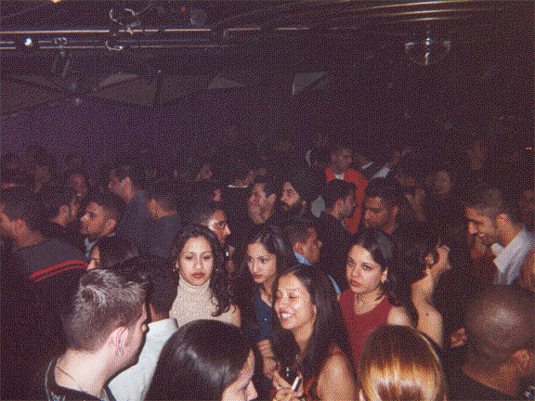
In the age of Science there seems to be no reason for us to hold on to the religion.
Of course, it was needed by the primitive, uneducated and unorganized society.
Those periods are over, we are now ready to enter the 21st century.
Let us shake off this unnecessary and out-of-date philosophy of faith and found a homogeneous society without religion to enter into the modern era of science.

Slide 14

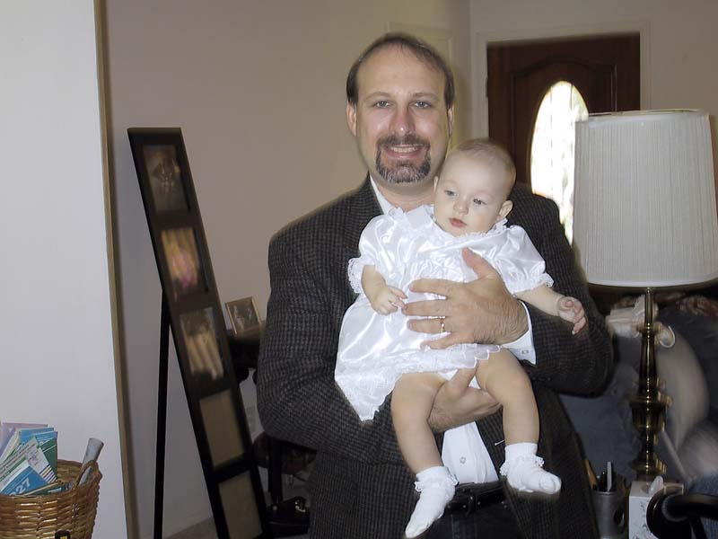
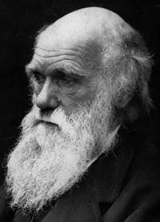

Reasons of retaining religion as it is?
We humans go through the same biological functions as other animals yet we are considered different and superior than all of them.
We claim this because we have the unique faculty to understand that we humans have a mission or purpose in life other than to just exist, procreate and die as other living beings do.
Life's Journey
Notes:
This Shabad is by Guru Nanak Dev Ji in Raag Maajh on Pannaa 138
mÚ 1 ]
ma 1 ||
First Mehl:
ds bwlqix bIs rvix qIsw kw suMdru khwvY ]
dhas baalathan bees ravan theesaa kaa su(n)dhar kehaavai ||
At the age of ten, he is a child; at twenty, a youth, and at thirty, he is called handsome.
cwlIsI puru hoie pcwsI pgu iKsY sTI ky boFypw AwvY ]
chaaleesee pur hoe pachaasee pag khisai sat(h)ee kae bodtaepaa aavai ||
At forty, he is full of life; at fifty, his foot slips, and at sixty, old age is upon him.
sqir kw miqhIxu AsIhW kw ivauhwru n pwvY ]
sathar kaa mathiheen aseehaa(n) kaa viouhaar n paavai ||
At seventy, he loses his intellect, and at eighty, he cannot perform his duties.
nvY kw ishjwsxI mUil n jwxY Ap blu ]
navai kaa sihajaasanee mool n jaanai ap bal ||
At ninety, he lies in his bed, and he cannot understand his weakness.
FMFoilmu FUiFmu ifTu mY nwnk jgu DUey kw Dvlhru ]3]
dta(n)dtolim dtoodtim ddit(h) mai naanak jag dhhooeae kaa dhhavalehar ||3||
After seeking and searching for such a long time, O Nanak, I have seen that the world is just a mansion of smoke. ||3||

Slide 15

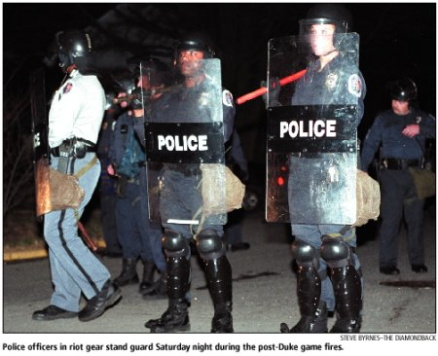
Spiritual Laws
(WE CANNOT GET AWAY!)
This mission is provided only by religion.
Actually religion provides a lot more than mere discipline to keep peace in society.
It gives meaning to the life of human beings.
Religion tells what human beings are to achieve besides just completing the biological cycle as Homo sapiens.
Material Laws
(MAYBE WE CAN GET AWAY WITH)

Slide 16
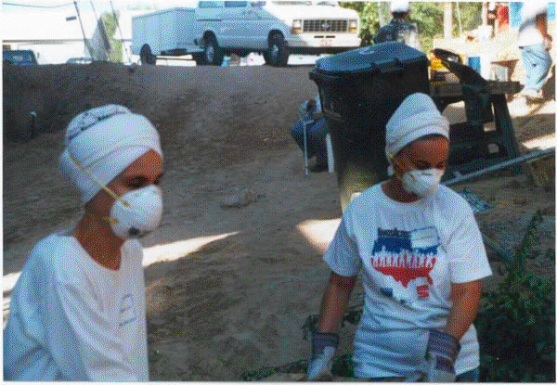
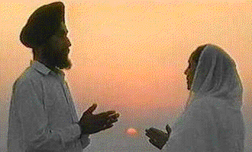
Humans live not only to enjoy their life and continue their species but they have a purpose in life as well.
No scientist, sociologist or scholar can tell that purpose.
What one is expected to do with one's life can only be explained by a holy person, whom we call a prophet or guide.
The mission and the path advised to be followed by a devotee is named religion or faith.
That is how we have so many religions today.

Slide 17
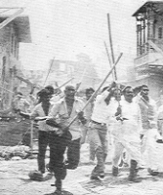
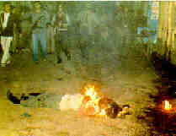

Discussing the negative aspect of religion, as a cause of hatred and war, it was found that it is politicians who misuse religion, otherwise, there is nothing inherently wrong in the philosophy of religion.
Also, politicians split people into nations, ethnic groups, linguistic divisions, regional units, etc., to make people fight with each other.
They even divide professional people to create conflicts amongst them.

Slide 18

The groups fight for their economic and political benefits.
Politicians will use anything and everything to divide humanity; religion is just one of them.
It is the people who must stand up against corrupt politicians when they misuse it.

Slide 19
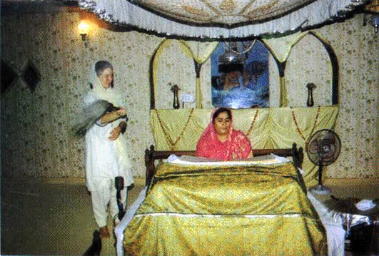
Believing in faith is essential to raise the status of Homo sapiens above the animal kingdom.
It is only the practice of our faith, which gives us the title of human beings, otherwise, biologically we are no different from animals.

